Slide 1
Comparing SVM Classification Performance: Three Different Kernels
Name: Yash Wadhwa
NUID: 002778382

Slide 2
INTRODUCTION
Support Vector Machines (SVMs) are a popular machine learning technique used for classification tasks. In this presentation, we will explore the use of SVMs with three commonly used kernels: linear, polynomial, and radial basis function (RBF). The choice of kernel can significantly impact the performance of an SVM model, and we will compare their performances on a dataset. We will discuss the intuition behind SVMs and their ability to handle complex datasets. Through this presentation, we will gain a deeper understanding of SVM classification and its power in making informed decisions.

Slide 3
SVM Classification techniques
SVMs are a popular machine learning technique used for classification tasks due to their ability to handle complex datasets and their versatility in kernel selection.
The choice of kernel can significantly impact the performance of an SVM model. Commonly used kernels include linear, polynomial, and radial basis function (RBF), each with its own pros and cons.
SVM classification techniques have various real-world applications, such as in predicting creditworthiness, medical diagnosis, and image classification.

Slide 4
Linear, Polynomial and RBF Kernel
Linear kernel: The linear kernel is the simplest kernel function and is used for linear classification. It works by creating a linear boundary between classes in the input space.
Polynomial kernel: The polynomial kernel is a non-linear kernel function that maps the input data into a higher-dimensional feature space. It is used to capture non-linear relationships between input variables and is often used in image processing and computer vision.
RBF kernel: The RBF (Radial Basis Function) kernel is a non-linear kernel function that is commonly used in Support Vector Machines (SVMs) for classification and regression. It maps the input data into an infinite-dimensional feature space and works by creating a circular boundary around each data point.

Slide 5
Technical Approach
The loan dataset was loaded using Pandas' read_excel function and the data was analyzed using various methods of Pandas such as head(), isnull(), and get_dummies() to perform data preprocessing tasks such as replacing string data with numerical values and one-hot encoding of categorical features.
The scaled data was created by applying the normalization technique to the independent variables and was split into training and testing sets using the train_test_split method of the Scikit-Learn library.
Support Vector Machine (SVM) models were created using three different types of kernel functions, including Linear, Polynomial, and RBF kernels, and the performance of these models was compared using accuracy_score metric.
Two SVM models were created using Polynomial and RBF kernels, with cost function value set as 100, and their accuracy was measured.
Finally, an SVM model was created using a linear kernel and cost function value set as 0.01. The model's decision boundary and margins were plotted using the decision_function method of the SVC class and the support vectors of the model were plotted on the graph.

Slide 6
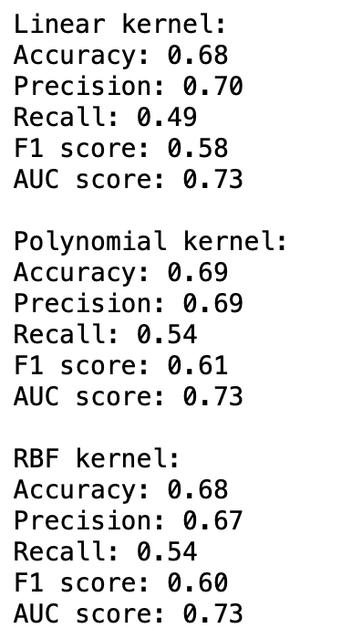
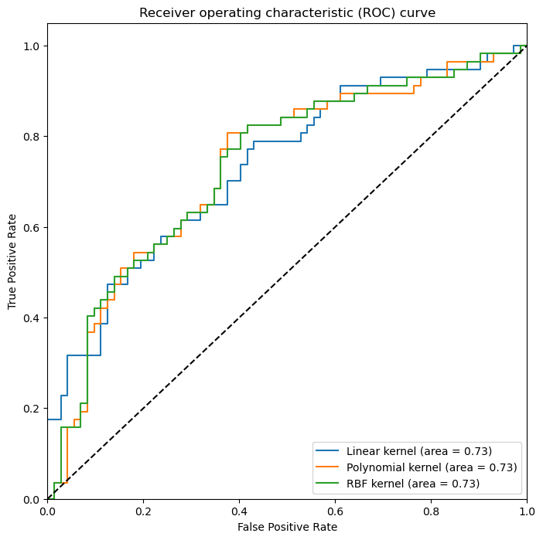
Output:
Scores Obtained from the Three Kernels
ROC Curve

Slide 7
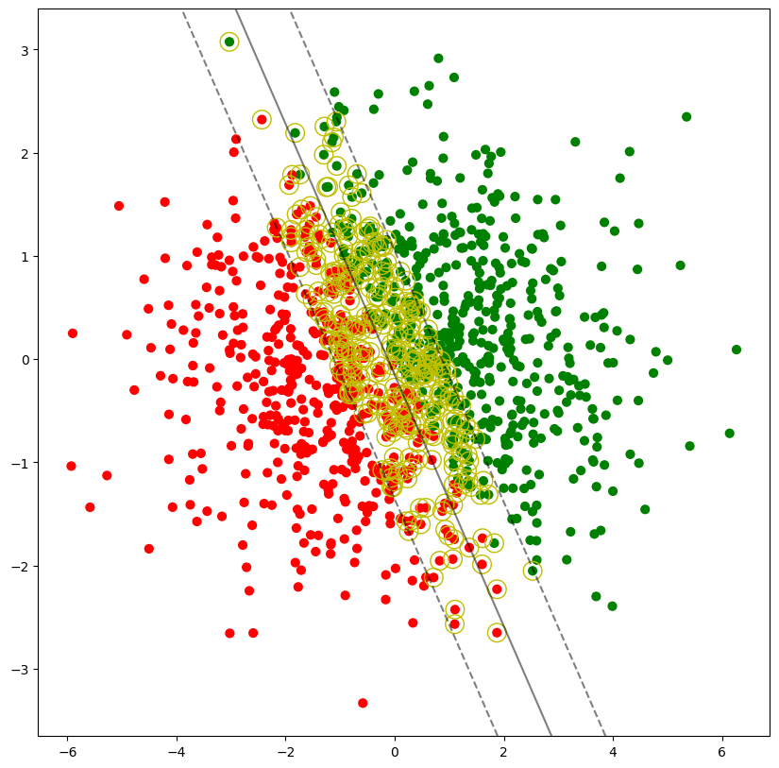
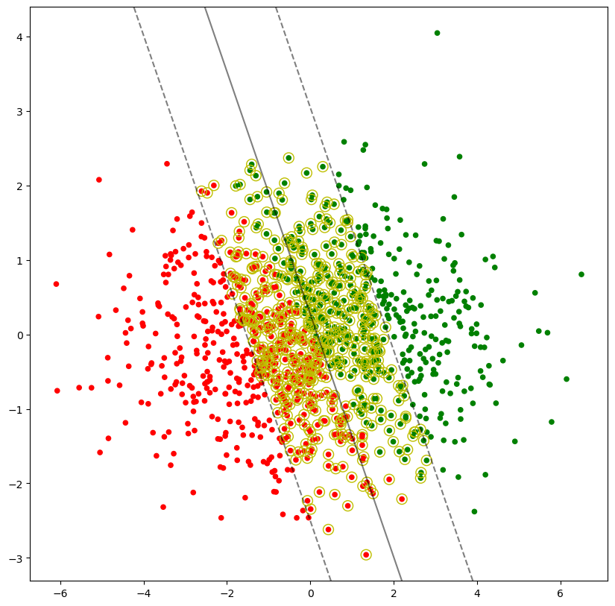
Scatter plots
C as 0.01
C as 0.01; Degree as 1
Linear
Polynomial

Slide 8
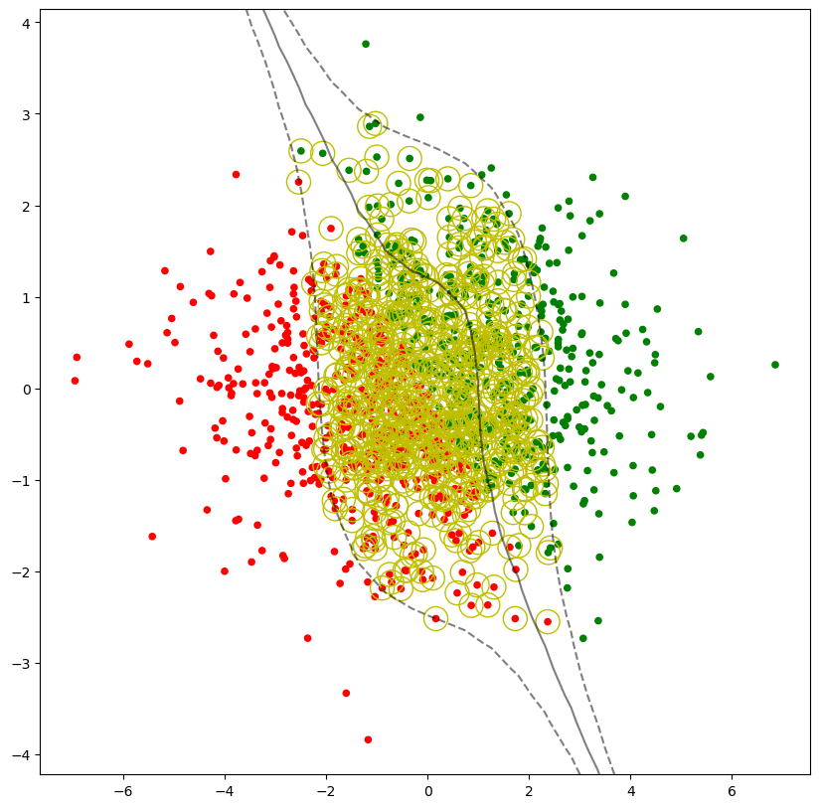
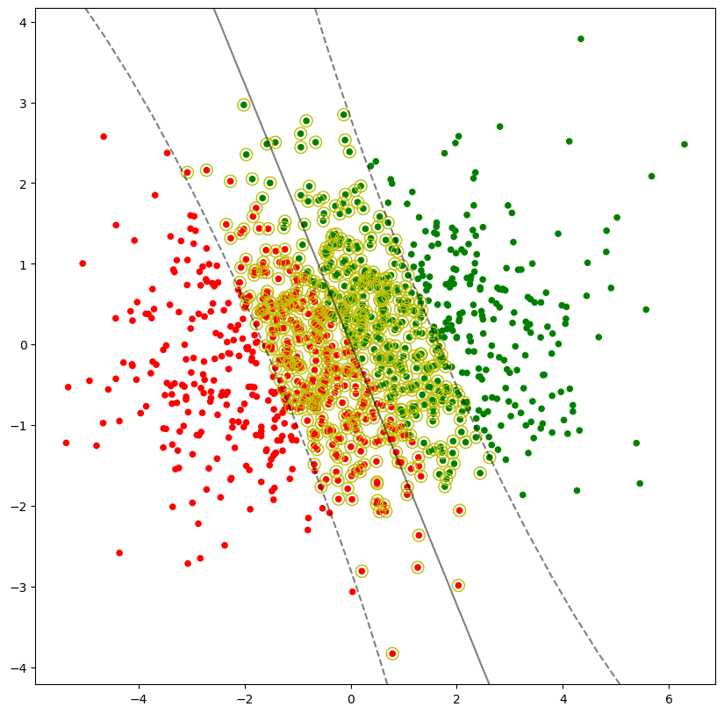
Scatter plots
C as 0.01; Degree as 3
C as 0.01; Degree as 1
Polynomial
RBF (Radial Basis Function)

Slide 9
Conclusion
The polynomial kernel achieved the highest F1 score of 0.61 and a comparable AUC score of 0.73, making it the best choice for achieving a balance between precision and recall.
The linear kernel achieved a precision score of 0.70, but its lower recall score of 0.49 resulted in a lower F1 score of 0.58.
The RBF kernel achieved a similar AUC score of 0.73 as the other kernels, but its F1 score of 0.60 and precision score of 0.67 were lower compared to the polynomial and linear kernels.
Overall, the results demonstrate that the choice of kernel can significantly impact the performance of a support vector machine model. By selecting the appropriate kernel for a given task, better performance can be achieved in terms of accuracy, precision, recall, F1 score, and AUC score.

Slide 10
Thank you!

